Slide 1


Exploratory Data Analysis (EDA)
Telkom University
Dr. Risman Adnan Mattotorang

Slide 2

Outline – Exploratory Analysis
Fundamentals of EA
Objectives and Scopes of EA
Statistical Summary of Data
Numerical Data
Statistical Hypothesis Testing
Confirmatory Data Analysis
Dimensionality Reduction
LDA, PCA and SVD for EDA

Slide 3
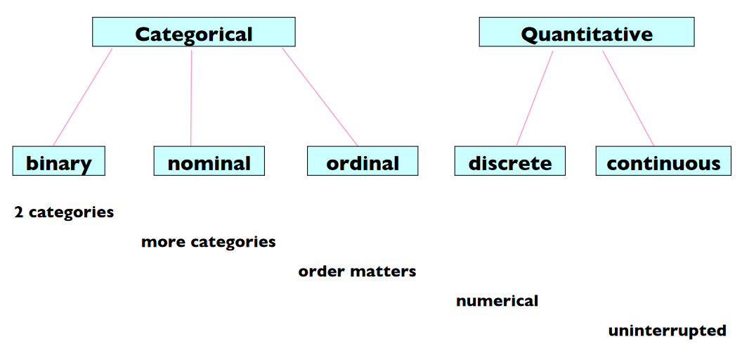
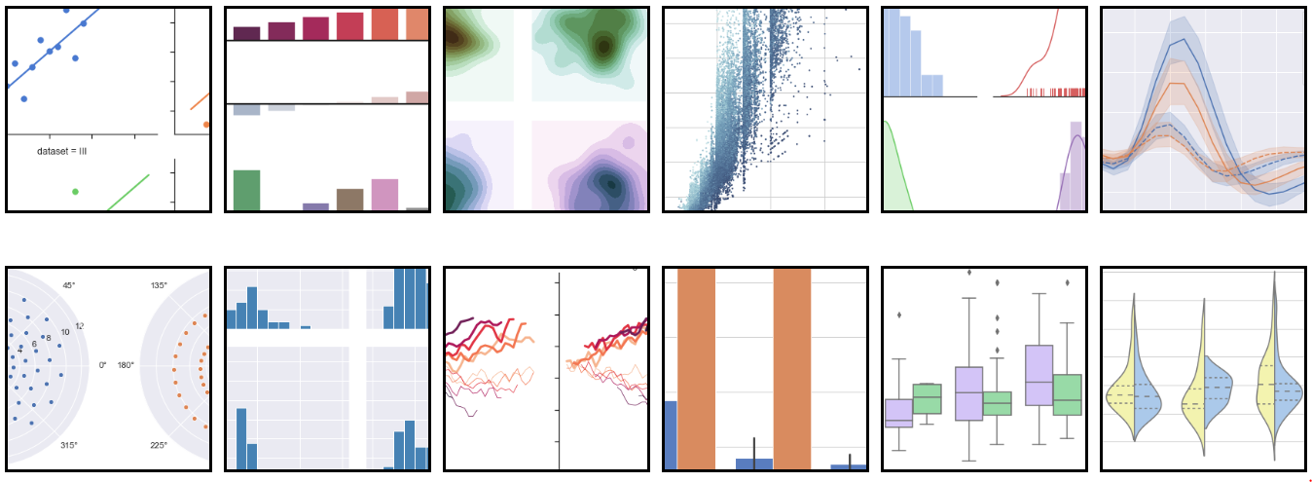
Recall: Key Principles of Visualization
Review Types and Dimension of Data
Univariate and Multivariate
Show Comparisons
Show Causality/Systematic Structure
Visualize Multivariate Data
Integration of Evidences
Describe Evidences with Proper Scales
Data Understanding is the King!

Slide 4
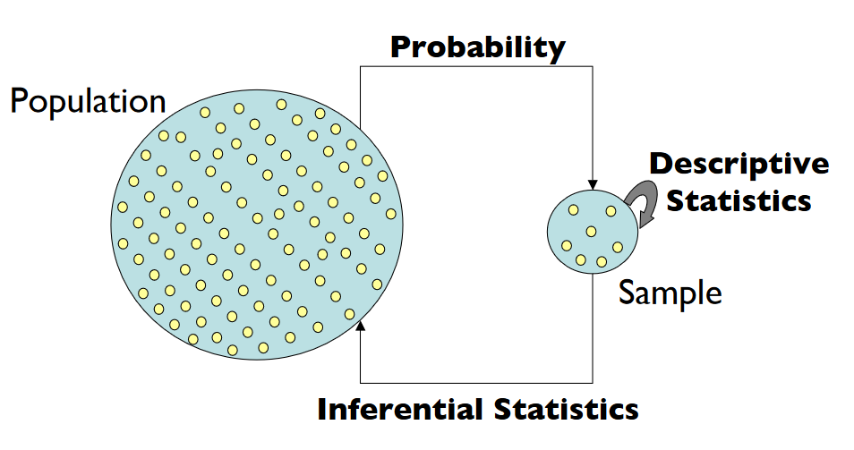
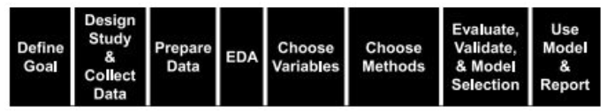
Scopes of EA
Not the same thing...
Probability teaches us how to predict future events.
Statistics focuses on analysis of the frequency of past events.
Statistics is how we learn from past experiences.
Exploratory Data Analysis (EA) is concerned with “how to best learn from what data we have”.

Slide 5

Exploratory Analysis
Before making ML/DL prediction and inference from data it is essential to examine all your variables.
Why? To listen to the data:
To see patterns & structures in the data
To catch mistakes and biases
To find violations of statistical assumptions
To find outliers/anomalies in data
To assess relationship in data
Explanatory variables = independent variables
Response variables = dependent variables
To generate hypotheses...
and because … if we don’t, we will have troubles later

Slide 6
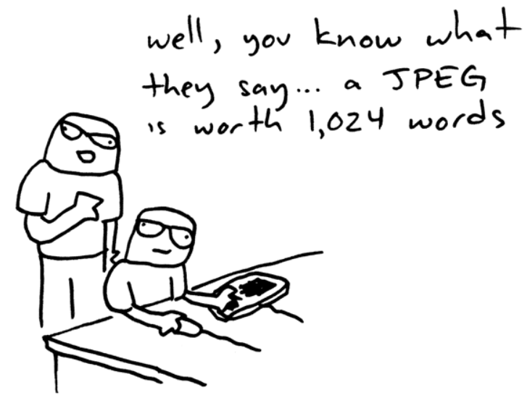
Exploratory Data Analysis
John Tukey (1961) EDA Focus on:
Understand the data’s underlying structure
Develop intuition about the data set
How the data were collected (to aid in cleaning)
How to further investigate with statistical methods
EDA is Any Initial Investigations of Data:
Basic: Data Visualization and Numerical Summary
Intermediate: Statistical Hypothesis Tests with Confirmatory Analysis
Advanced: Unsupervised learning, PCA, SVD and Clustering
Notes:
Tukey defined data analysis in 1961 as: " Procedures for analyzing data, techniques for interpreting the results of such procedures, ways of planning the gathering of data to make its analysis easier, more precise or more accurate, and all the machinery and results of (mathematical) statistics which apply to analyzing data.

Slide 7



Recall: Data Wrangling
Data Wrangling, sometimes referred to as data munging, is the process of transforming, mapping and manipulate data from one "raw and messy" data form into another format with the intent of making it more appropriate. If Pandas is not productive enough, you can try: DataWrangler, OpenRefine or AutoMunge.
Automunge is a tool for automating the final steps of data wrangling of structured (tabular) data prior to the application of machine learning.

Slide 8
Outline – Exploratory Analysis
Fundamentals of EA
Objectives and Scopes of EA
Statistical Summary of Data
Numerical Data
Statistical Hypothesis Testing
Confirmatory Data Analysis
Dimensionality Reduction
LDA, PCA and SVD for EDA

Slide 9
Numerical Summaries of Data
Question: What summary we have concern?
Central Tendency Measures. Give a “center” around which the measurements in the data.
Variation or Variability Measures. Describe “data spread” or how far away from center.
Relative Standing Measures. Describe relative position of specific measurements in the data.
What is Numerical Summaries?
Help to describe and compare samples
Give information about corresponding parameters
Qualitative data can be summarized by counts or percentages.
Quantitative data can be summarized by measures of location, scale and shape.

Slide 10
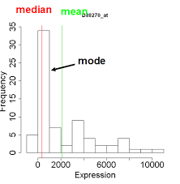
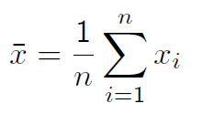
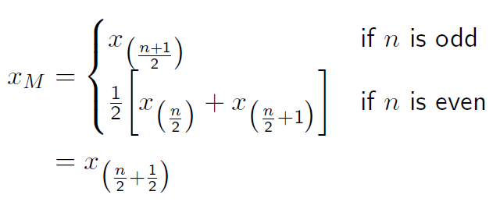
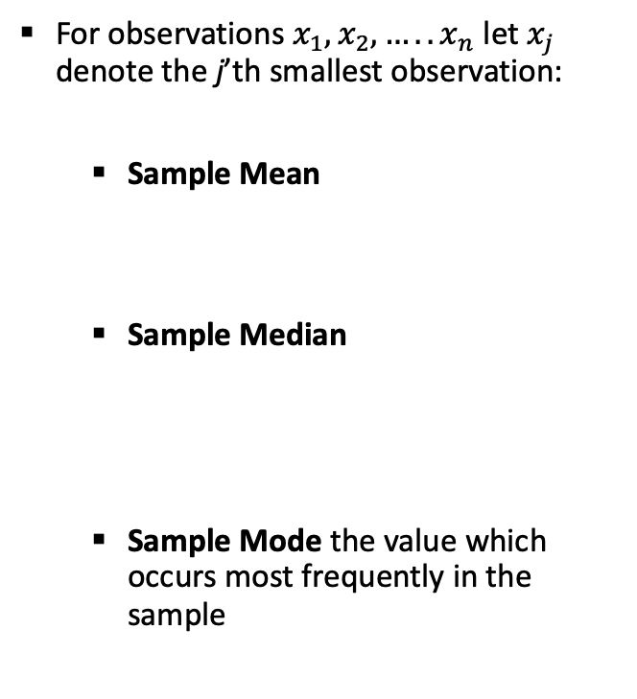
Measures of Location
For observations $x_{1},x_{2},…..x_{n}$ let $x_{j}$ denote the j’th smallest observation:
Sample Mean
Sample Median
Sample Mode the value which occurs most frequently in the sample

Slide 11
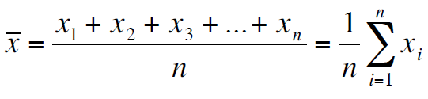
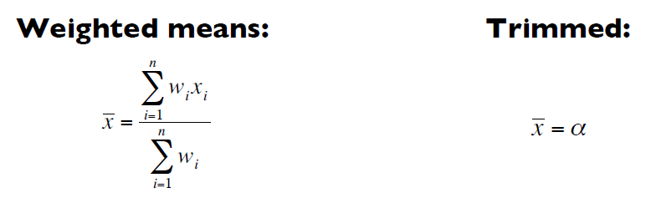
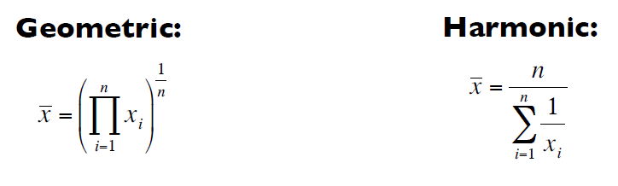
Location: Mean
The Mean: To calculate the average of a set of observations, add their value and divide by the number of observations.

Slide 12

Location: Median
Median – the exact middle value
Calculation:
If there are an odd number of observations, find the middle value
If there are an even number of observations, find the middle two values and average them
Example: Age of participants: 17 19 21 22 23 23 23 38
Median =

Slide 13
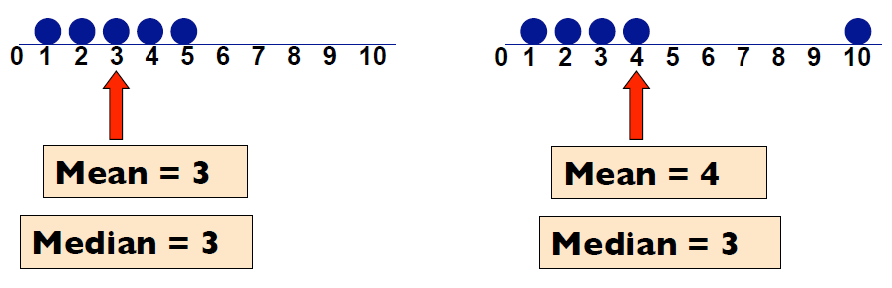
Which Location Measure is Best?
Mean is best for symmetric distributions without outliers
Median is useful for skewed distributions or data with outliers

Slide 14
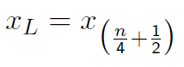
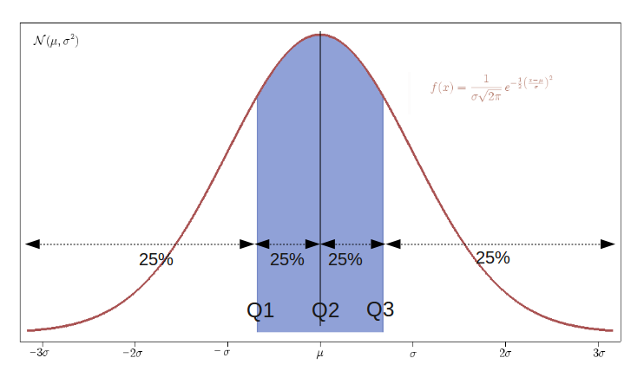
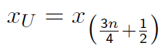
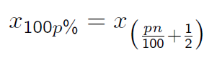
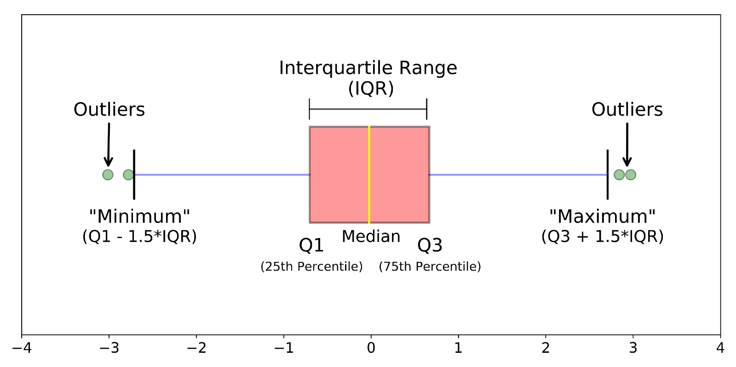
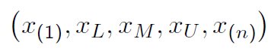
Location: Quantiles
Sample Lower Quantiles:
Sample Upper Quantiles:
pth Sample Percentile:
Five Number Summary:

Slide 15
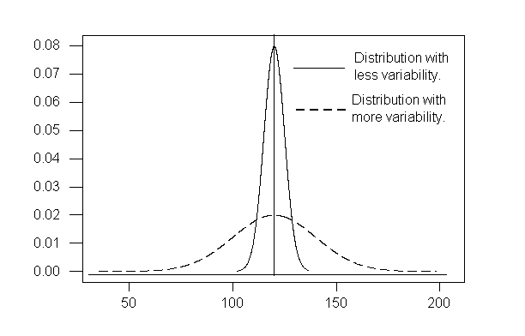
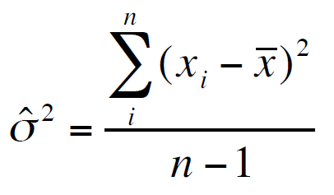
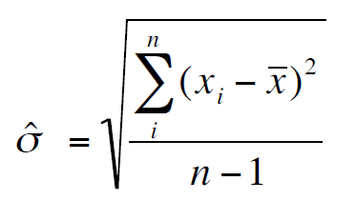
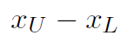

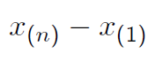
Measures of Scale: ANOVA
Sample Variance:
Sample Standard Deviation:
Inter-Quartile Range (IQR):
Sample Range:

Slide 16
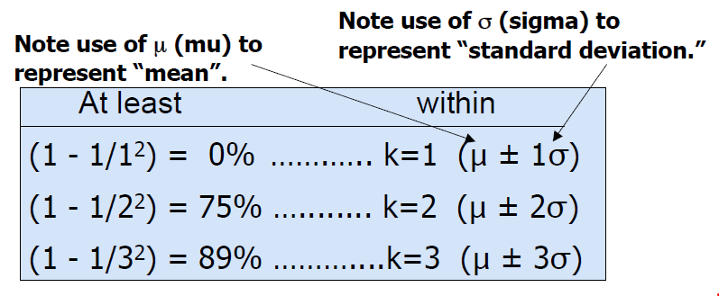
Interesting Theoretical Results
Regardless of how the data are distributed, a certain percentage of values must fall within k standard deviations from the mean:

Slide 17
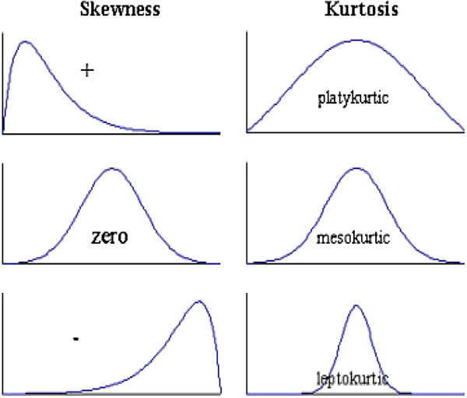
Measures of Shape
Modality number of peaks in the sample distribution
Skewness is measure of symmetry in a distributions:
0 : symmetric sample distribution
+ : skewed to the right (long right-hand tail)
– : skewed to the left (long left-hand tail)
Kurtosis is a measure of combined sizes of the two tails:
3 : same peakedness as the normal distribution (Mesokurtic)
> 3 : more peaked - slim or long-tailed (Leptokurtic)
< 3: less peaked - flat, fat or short-tailed (Platykurtic)
Sometimes adjusted to give 0 for Mesokurtic distributions.

Slide 18
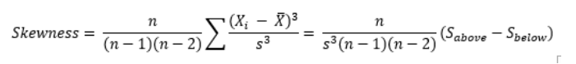
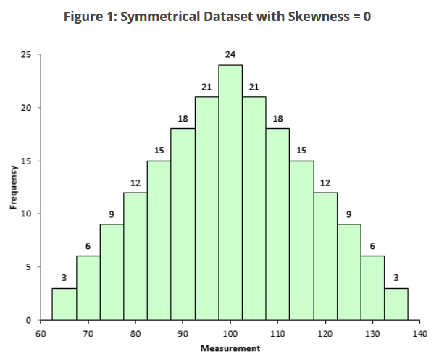
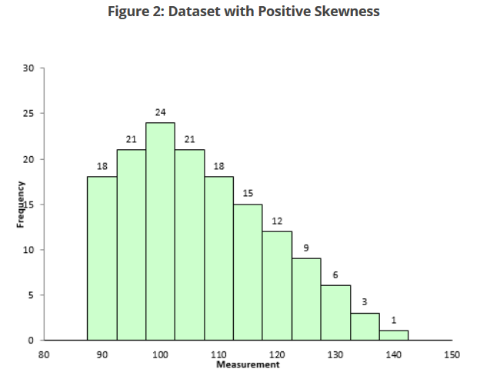
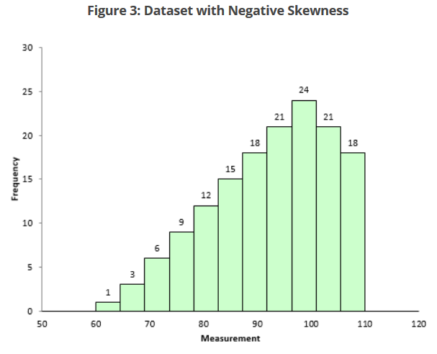
Skewness
Definition:

Slide 19
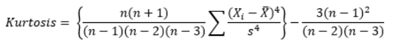
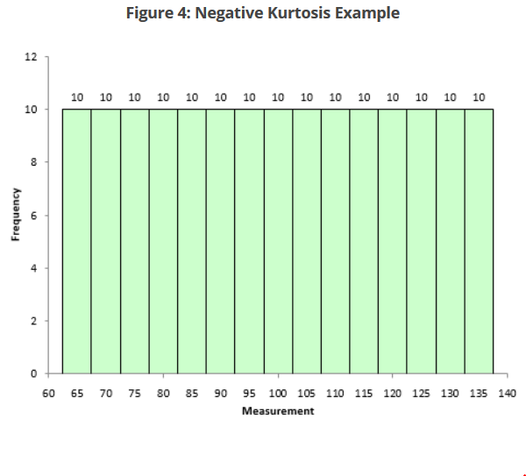
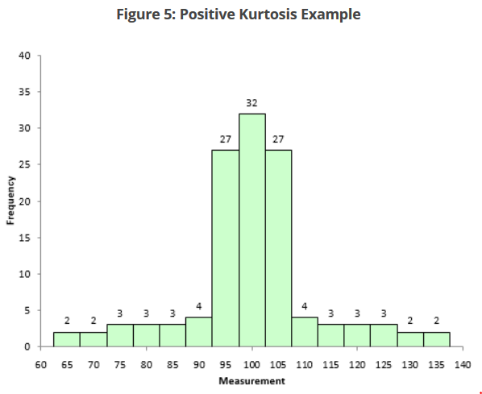
Kurtosis
Definition:
Kurtosis is the degree of peakedness of a distribution – Wolfram MathWorld

Slide 20
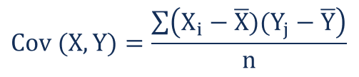
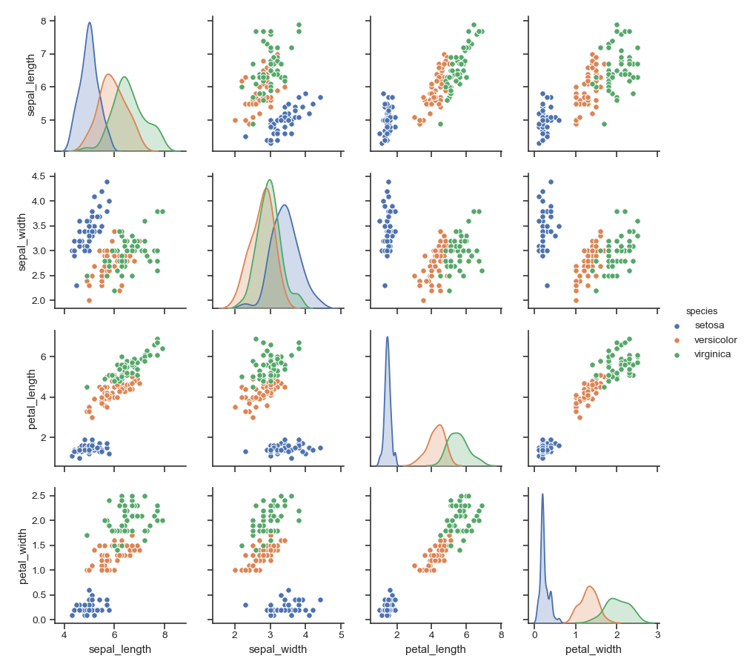
Covariance & Scatterplot
Covariance is a measure of the joint variability.
Positive Covariance: variables show similar behavior.
Negative Covariance: variables show opposite behavior.
The sign of the covariance shows the tendency in the linear relationship between the variables. The magnitude of the covariance is not easy to interpret.
The normalized version of the covariance, the correlation coefficient, however, shows by its magnitude the strength of the linear relation.

Slide 21
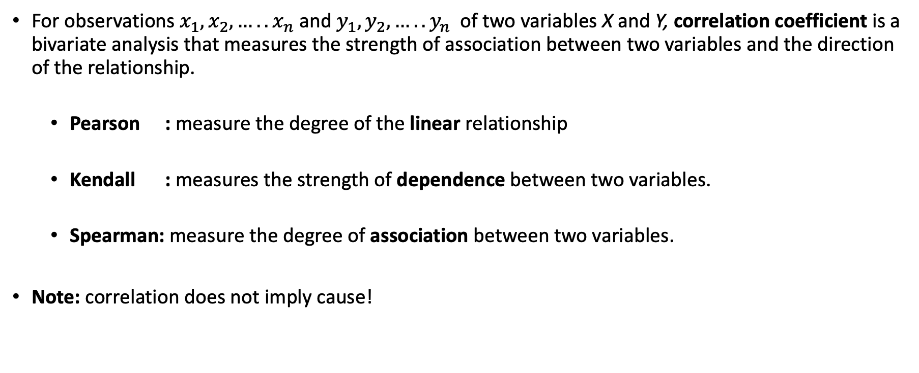
Correlation Coefficient (Bivariate)
For observations $x_{1},x_{2},…..x_{n}$ and $y_{1},y_{2},…..y_{n}$ of two variables X and Y, correlation coefficient is a bivariate analysis that measures the strength of association between two variables and the direction of the relationship.
Pearson : measure the degree of the linear relationship
Kendall : measures the strength of dependence between two variables.
Spearman: measure the degree of association between two variables.
Note: correlation does not imply cause!

Slide 22
Multivariate Analysis (MANOVA)
Multivariate Analysis of Variance (MANOVA) is based on the statistical principle of multivariate statistics, which involves observation and analysis of more than one statistical outcome variable at a time.
Uses for multivariate analysis include:
Design for capability (also known as capability-based design)
Inverse design, where any variable can be treated as an independent variable
Analysis of Alternatives (AoA), the selection of concepts
Analysis of concepts with respect to changing scenarios
Identification of critical design-drivers and correlations

Slide 23
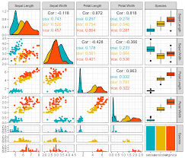
Multivariate Analysis (MANOVA)
MVA contains several process below:
Plotting Multivariate Data: Matrix Scatterplot and Profile Plot
Calculating Summary of Statistics: Means, Variances, Correlations
Principal Component Analysis (PCA)
Linear Discriminant Analysis (LDA)
Python Reference: https://python-for-multivariate-analysis.readthedocs.io/

Slide 24
Outline – Exploratory Analysis
Fundamentals of EA
Objectives and Scopes of EA
Statistical Summary of Data
Numerical Data
Statistical Hypothesis Testing
Confirmatory Data Analysis
Dimensionality Reduction
LDA, PCA and SVD for EDA

Slide 25
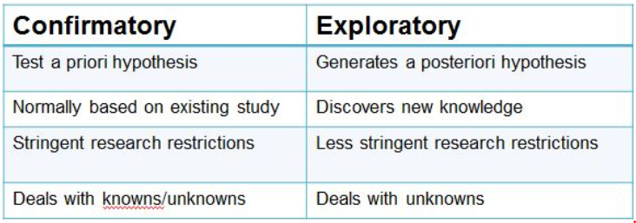
Incorporating Models
Exploratory data analysis is sometimes compared to detective work: it is the process of gathering evidence. Confirmatory data analysis is comparable to a court trial: it is the process of evaluating evidence. Exploratory analysis and confirmatory analysis can—and should—proceed side by side" (Tukey; 1977).

Slide 26
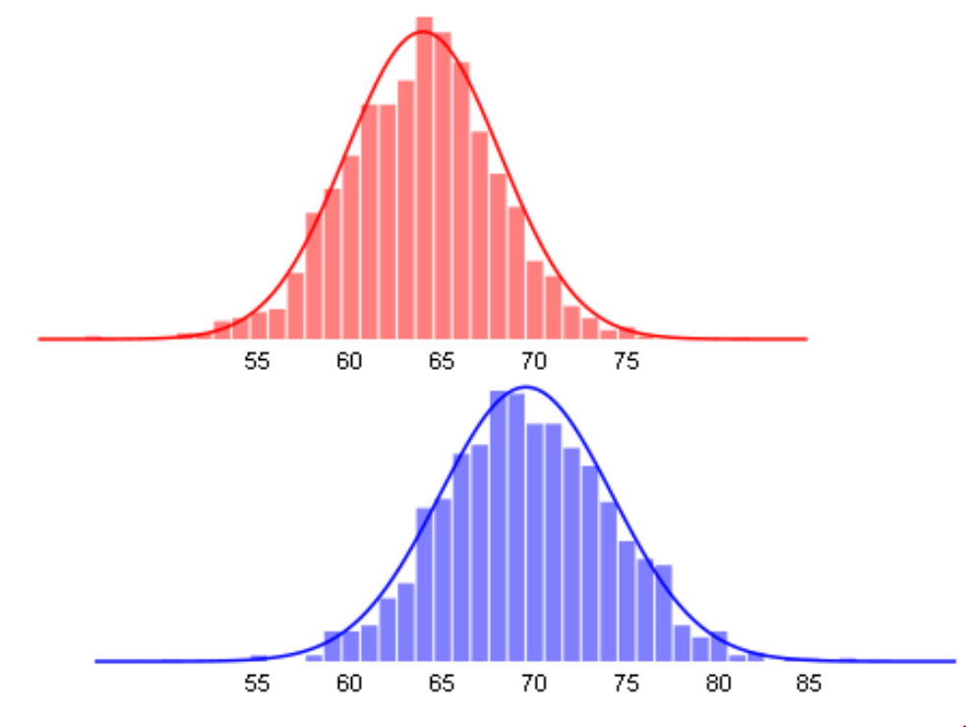
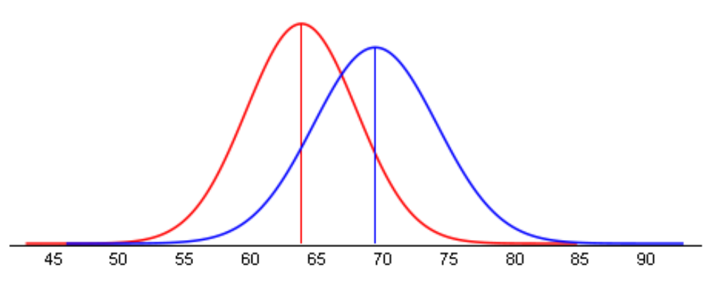
Example: Heights by Gender
Gender Male / Female
Height (in) Number
μm = 69.4 σm = 4.69 Nm = 1000
μf = 63.8 σf = 4.18 Nf = 1000
Is the difference in heights significant?
In other words: assuming no true difference, what is the probability that our data is due to chance?

Slide 27
Formulating Hypothesis
Null Hypothesis (H0) : μm = μf (population)
Alternate Hypothesis (Ha) : μm ≠ μf (population)
A statistical hypothesis test assesses the likelihood of the null hypothesis.
What is the probability of sampling the observed data assuming the population means are equal?
This is called the p-value. Testing procedure, compute a test statistic.

Slide 28
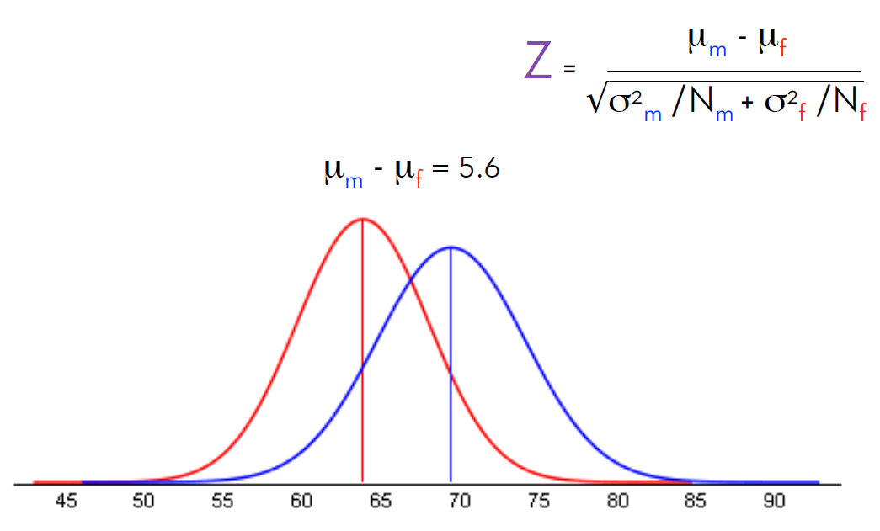
Testing Procedure
Compute a test statistic. This is a number that in essence summarizes the difference.
The possible values of this statistic come from a known probability distribution.
According to this distribution, determine the probability of seeing a value meeting or exceeding the test statistic. This is the p-value.

Slide 29
Statistical Significance
In general, a test statistic is selected or defined in such a way as to quantify, within observed data, behaviors that would distinguish the null from the alternative hypothesis, where such an alternative is prescribed, or that would characterize the null hypothesis if there is no explicitly stated alternative hypothesis. Two widely used test statistics are the t-statistic and the F-test.
Interpretation:
The threshold at which we consider it safe (or reasonable?) to reject the null hypothesis.
If p < 0.05, we typically say that the observed effect or difference is statistically significant.
This means that there is a less than 5% chance that the observed data is due to chance.
Note that the choice of 0.05 is a somewhat arbitrary threshold (chosen by R. A. Fisher)

Slide 30
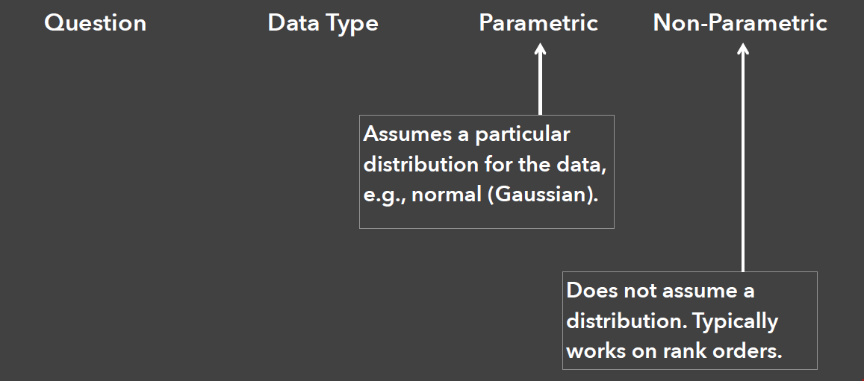
Common Statistical Methods

Slide 31
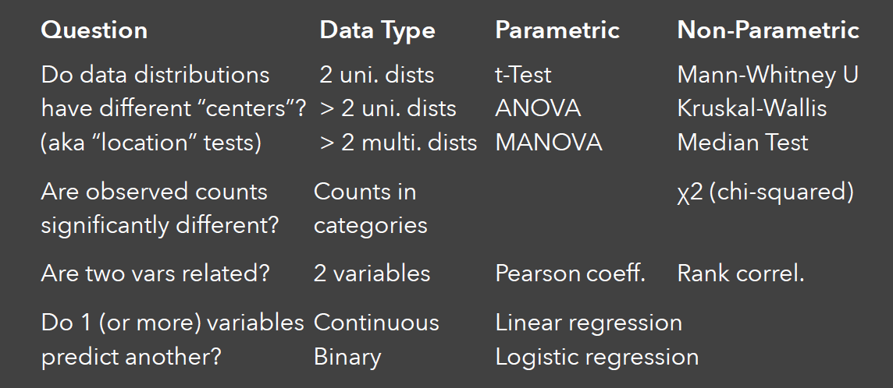
Common Statistical Methods

Slide 32
Outline – Exploratory Analysis
Fundamentals of EA
Objectives and Scopes of EA
Statistical Summary of Data
Numerical Data
Statistical Hypothesis Testing
Confirmatory Data Analysis
Dimensionality Reduction
LDA, PCA and SVD for EDA

Slide 33
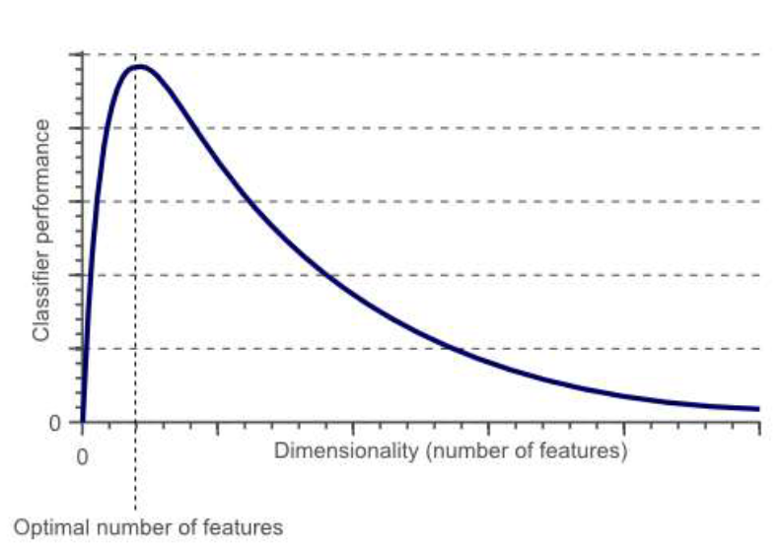
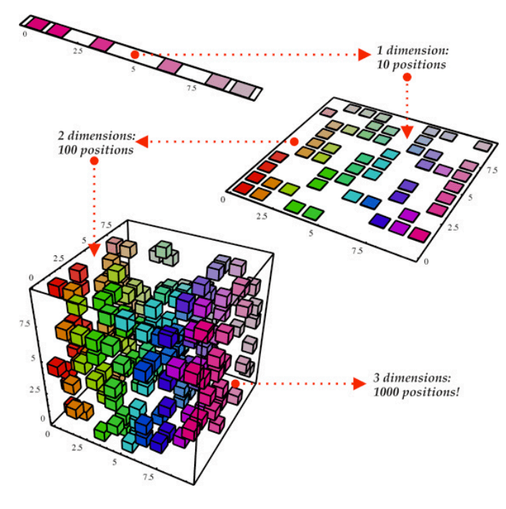
Dimensionality Reduction
Problems: Curse of Dimensionality
Theoretically, increasing features should improve performance. In practice, too many features leads to worse performance. Number of training examples required increases exponentially with dimensionality.
Solutions: Dimensionality Reduction
Data can be represented by fewer dimensions (features). Reduce dimensionality by selecting subset (feature elimination). Combine with linear and non-linear transformations

Slide 34
Scopes of Dimensionality Reduction
Dimensionality reduction techniques reduce number of features of the training dataset.
This reduction is necessary to:
Eliminate the noise from the data
Visualize the data in 2 or 3 dimensions
Speed up the learning process
Enhance the learning results by eliminating correlated features.
Eliminate unnecessary features.
Compress the data size.
Two main approaches:
Projection : project or map the data into a lower dimensional space (Eq. PCA, SVD).
Manifold : data in higher dimension is a manifold of lower dimension (Eq. MDS, LLE, etc).

Slide 35
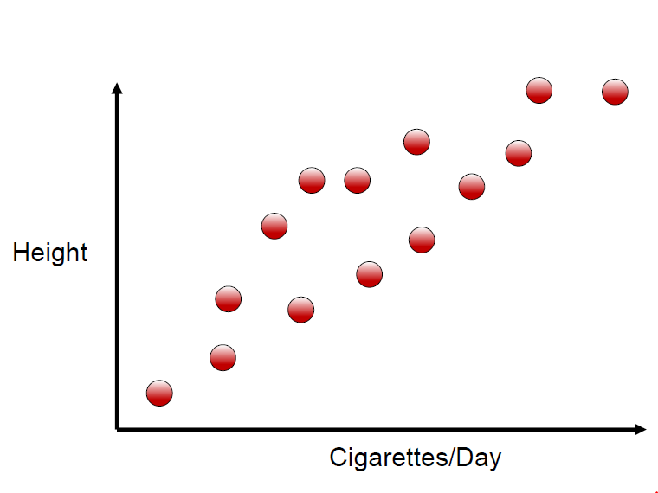
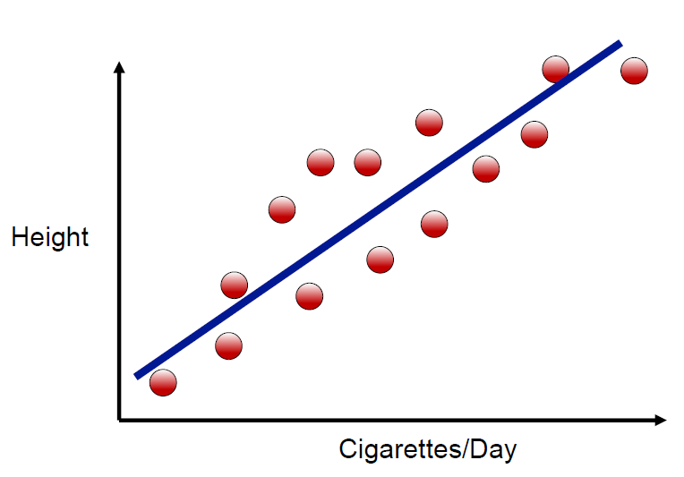
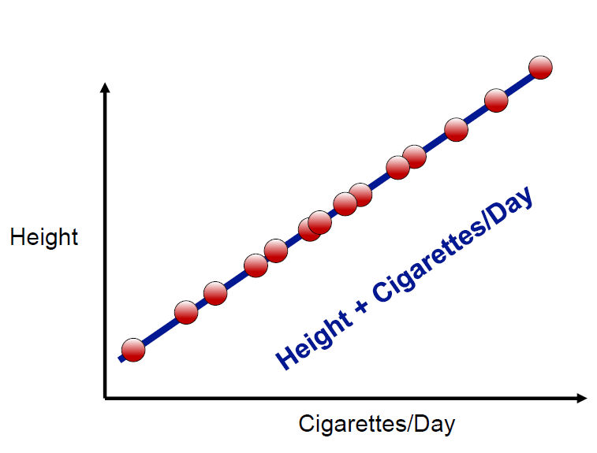
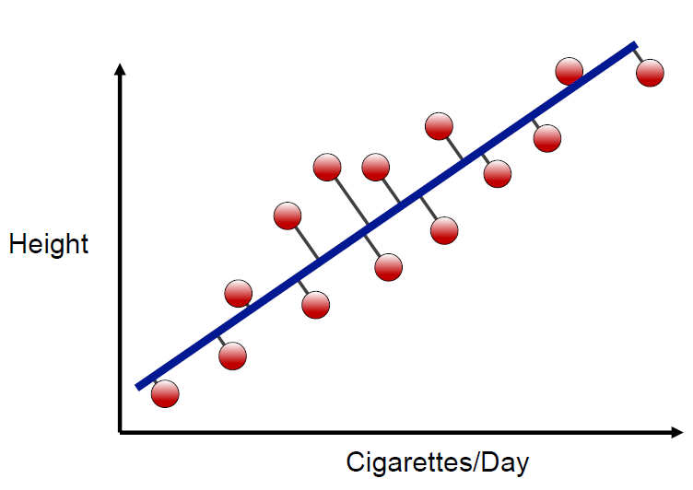
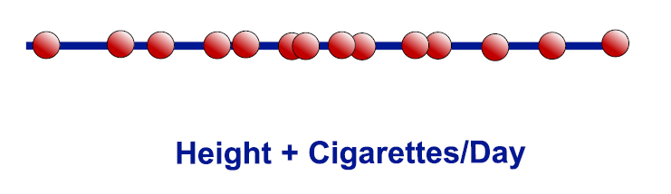
Solution: Dimensionality Reduction
Sample Case:
Two features: height and cigarettes per day
Both features increase together (correlated)
Can we reduce number of features to one?
Dimensionality Reduction:
Create single feature that is combination of
height and cigarettes. This is Principal
Component Analysis (PCA).

Slide 36
What we will learn
LDA: Linear Discriminant Analysis
Approach: Find a linear combination of features that characterizes or separates two or more classes of objects or events.
PCA: Principal Component Analysis
Approach: Uses an orthogonal transformation to convert bigger set of features intro smaller set of linearly uncorrelated variables called principal components.
SVD: Singular Value Decomposition
Approach: Use matrix decomposition to find best projection axis with minimum reconstruction error.

Slide 37


LDA vs PCA
StatsQuest LDA
StatsQuest PCA

Slide 38


Linear Discriminant Analysis
LDA: Pick a new dimension that gives:
Maximum separation of means of projected classes
Minimum variance between each projected class
Solution: Eigenvectors based on between-class and within-class covariance matrices.

Slide 39




Linear Discriminant Analysis
LDA Definition: A linear combination of features separates two or more classes. It is a supervised dimensionality reduction technique to be used with continuous independent variables and a categorical dependent variables. LDA does classification by assuming that the data within each class are normally distributed:
We allow each class to have its own mean $μ_{k}$ , but we assume a common variance matrix $Σ$. Thus
LDA Task: Find k so that is the largest.

Slide 40



Linear Discriminant Analysis
The linear discriminant functions are derived from the relation:
And we denote:
The decision rule is:

Slide 41

LDA Algorithms
Two main algorithms for LDA:
Fisher Discriminant Analysis
Gaussian classification rule with equal prior probabilities.
LDA by Optimal Scoring
Use multivariate linear regression on derived responses.

Slide 42
Advanced Topic on LDA (Reading Material)
FDA Generalization:
FDA – Flexible Discriminant Analysis
Allow non-linear decision boundary
PDA – Penalized Discriminant Analysis
Expand the predictors into a large basis set, and then penalize its coefficients to be smooth
MDA – Mixture Discriminant Analysis
Model each class by a mixture of two or more Gaussians with different centroids but same covariance, rather than a single Gaussian distribution as in LDA

Slide 43
Principal Component Analysis
PCA is “an orthogonal linear transformation that transfers the data to a new coordinate system such that the greatest variance by any projection of the data comes to lie on the first coordinate (first principal component), the second greatest variance lies on the second coordinate (second principal component), and so on.”
An exploratory technique to reduce the dimensionality of the data set, used to:
Reduce number of dimensions in data
Find patterns in high-dimensional data
Visualize data of high dimensionality

Slide 44





Principal Component Analysis
PCA decomposes a dataset into a set of successive orthogonal components that explain a maximum amount of variance.
Try: PCA Web Demo

Slide 45


Principal Component Analysis
Keys to Interpret PCA:
Variance: measure of the deviation from the mean for points in one dimension or measure of spread.
Covariance: measure of how much each of the dimensions varies from the mean with respect to each other.
+ Covariance: both increase of decrease together
- Covariance: one increases other decreases
0 Covariance: two dimension is independent.
Covariance: measure of how much each of the dimensions varies from the mean with respect to each other.
Covariance Matrix: Combination matrix of covariance
Eigen Value and Eigen Vector:

Slide 46


PCA for Embedding
An embedding is a relatively low-dimensional space into which you can translate high-dimensional vectors. Embeddings make it easier to do ML on large inputs like sparse vectors representing words. Projector: https://projector.tensorflow.org/ Video lecture here.

Slide 47



Singular Value Decomposition
Let A be an $m x n$ matrix. The Singular Value Decomposition(SVD) of A:
U is orthogonal $m x r$, V is $n x r$ orthogonal and $D$ is $r x r$ diagonal matrices.
A: Input data matrix (eg. m documents, n terms)
U: Left singular matrix (m documents, r concepts)
$D$: Singular value (strength of each concept)
V: Right singular matrix (n terms, r concepts)
$$A=U D V^{T}$$

Slide 48


Singular Value Decomposition

Slide 49

Singular Value Decomposition
SVD allows an exact representation of any matrix, and also makes it easy to eliminate the less important parts of that representation to produce an approximate representation with any desired number of dimensions
SVD gives best axis to project on:
Best = min sum of squares of projection error
In other words:
Best = minimum reconstruction error.

Slide 50


Interpretation of SVD
The key to understanding what SVD offers is in viewing the r columns of U, Σ, and V as representing concepts that are hidden in the original matrix M. These concepts are clear; one is “science fiction” and the other is “romance”.
http://infolab.stanford.edu/~ullman/mmds/ch11.pdf

Slide 51

Dimensionality Reduction with SVD
Q: How exactly dimensionality reduction in SVD?
A: As simple as setting the smallest singular value to zero

Slide 52
Homework
StatQuests (PCA, LDA, SVD)
Learn PCA, LDA and SVD in ScikitLearn
Learn Pandas Framework

Slide 53

THANKS
SRIN Academy – Data Intelligence
Risman Adnan Mattotorang

